Slide 1
Python Intermediate OOPS concepts
Dr. Rakhee Chhibber

Slide 2
Python OOP Concepts
Class in Python
Objects in Python
Polymorphism in Python
Encapsulation in Python
Inheritance in Python
Data Abstraction in Python

Slide 3
Introduction
Object Oriented Programming is a fundamental concept in Python, empowering developers to build modular, maintainable, and scalable applications.
OOPs is a way of organizing code that uses objects and classes to represent real-world entities and their behavior. In OOPs, object has attributes thing that has specific data and can perform certain actions using methods.

Slide 4
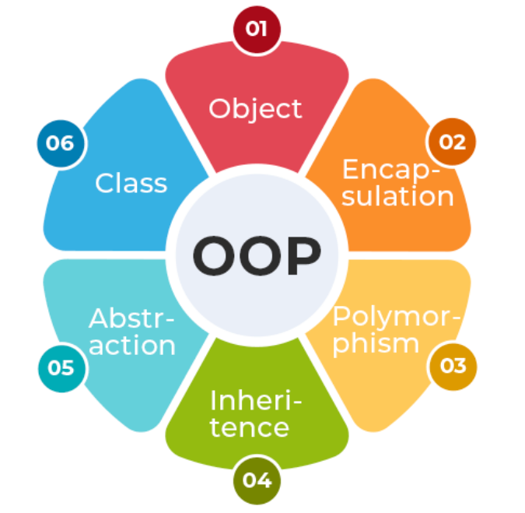

Slide 5
Python Class
A class is a collection of objects. Classes are blueprints for creating objects. A class defines a set of attributes and methods that the created objects (instances) can have.
Some points on Python class:
Classes are created by keyword class.
Attributes are the variables that belong to a class.
Attributes are always public and can be accessed using the dot (.) operator. Example: Myclass.Myattribute

Slide 6
Creating a Class
class Dog:
species = "Canine" # Class attribute
def __init__(self, name, age):
self.name = name # Instance attribute
self.age = age # Instance attribute

Slide 7
Python Objects
An Object is an instance of a Class. It represents a specific implementation of the class and holds its own data.
An object consists of:
State: It is represented by the attributes and reflects the properties of an object.
Behavior: It is represented by the methods of an object and reflects the response of an object to other objects.
Identity: It gives a unique name to an object and enables one object to interact with other objects

Slide 8
Creating Object
class Dog:
species = "Canine" # Class attribute
def __init__(self, name, age):
self.name = name # Instance attribute
self.age = age # Instance attribute
# Creating an object of the Dog class
dog1 = Dog("Buddy", 3)
print(dog1.name)
print(dog1.species)

Slide 9
Self Parameter - self parameter is a reference to the current instance of the class. It allows us to access the attributes and methods of the object
class Dog:
species = "Canine" # Class attribute
def __init__(self, name, age):
self.name = name # Instance attribute
self.age = age # Instance attribute
dog1 = Dog("Buddy", 3) # Create an instance of Dog
dog2 = Dog("Charlie", 5) # Create another instance of Dog
print(dog1.name, dog1.age, dog1.species) # Access instance and class attributes
print(dog2.name, dog2.age, dog2.species) # Access instance and class attributes
print(Dog.species) # Access class attribute directly

Slide 10
__init__ Method
class Dog:
def __init__(self, name, age):
self.name = name
self.age = age
dog1 = Dog("Buddy", 3)
print(dog1.name)
Explanation:
__init__: Special method used for initialization.
self.name and self.age: Instance attributes initialized in the constructor.

Slide 11
Class and Instance Variables
Class Variables
These are the variables that are shared across all instances of a class. It is defined at the class level, outside any methods. All objects of the class share the same value for a class variable unless explicitly overridden in an object.
Instance Variables
Variables that are unique to each instance (object) of a class. These are defined within the __init__ method or other instance methods. Each object maintains its own copy of instance variables, independent of other objects.

Slide 12
class Dog:
# Class variable
species = "Canine"
def __init__(self, name, age):
# Instance variables
self.name = name
self.age = age
# Create objects
dog1 = Dog("Buddy", 3)
dog2 = Dog("Charlie", 5)
# Access class and instance variables
print(dog1.species) # (Class variable)
print(dog1.name) # (Instance variable)
print(dog2.name) # (Instance variable)
# Modify instance variables
dog1.name = "Max"
print(dog1.name) # (Updated instance variable)
# Modify class variable
Dog.species = "Feline"
print(dog1.species) # (Updated class variable)
print(dog2.species)

Slide 13
Explanation
Class Variable (species): Shared by all instances of the class. Changing Dog.species affects all objects, as it's a property of the class itself.
Instance Variables (name, age): Defined in the __init__ method. Unique to each instance (e.g., dog1.name and dog2.name are different).
Accessing Variables: Class variables can be accessed via the class name (Dog.species) or an object (dog1.species). Instance variables are accessed via the object (dog1.name).
Updating Variables: Changing Dog.species affects all instances. Changing dog1.name only affects dog1 and does not impact dog2.

Slide 14
Python Inheritance
Inheritance allows a class (child class) to acquire properties and methods of another class (parent class). It supports hierarchical classification and promotes code reuse.

Slide 15
Types of Inheritance:
Single Inheritance: A child class inherits from a single parent class.
Multiple Inheritance: A child class inherits from more than one parent class.
Multilevel Inheritance: A child class inherits from a parent class, which in turn inherits from another class.
Hierarchical Inheritance: Multiple child classes inherit from a single parent class.
Hybrid Inheritance: A combination of two or more types of inheritance.

Slide 16
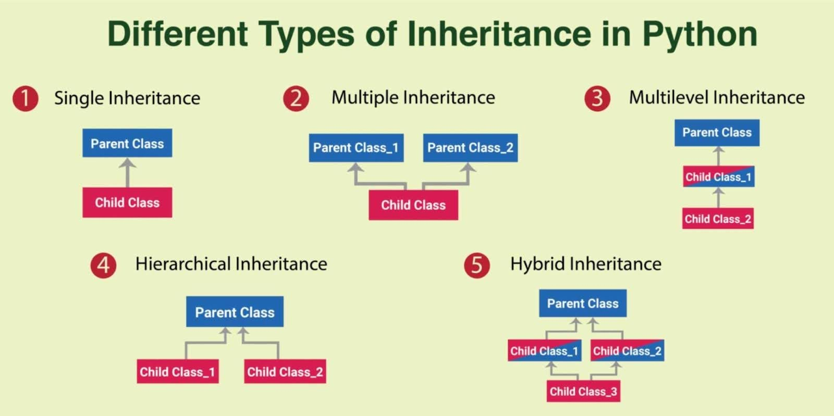

Slide 17
Single Inheritance
class Vehicle:
def start(self):
print("Vehicle started")
class Car(Vehicle):
def drive(self):
print("Car is driving")

Slide 18
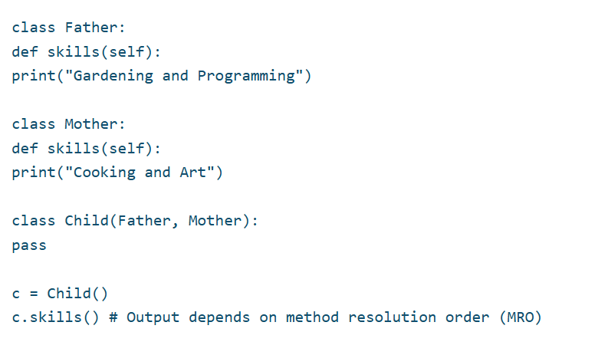
Multiple Inheritance

Slide 19
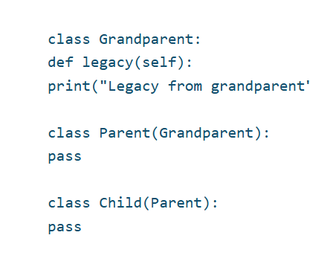
Multilevel

Slide 20
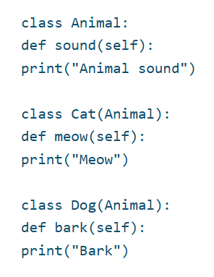
Hierarchical Inheritance

Slide 21
# Single Inheritance
class Dog:
def __init__(self, name):
self.name = name
def display_name(self):
print(f"Dog's Name: {self.name}")
class Labrador(Dog): # Single Inheritance
def sound(self):
print("Labrador woofs")

Slide 22
# Multilevel Inheritance
class GuideDog(Labrador): # Multilevel Inheritance
def guide(self):
print(f"{self.name}Guides the way!")
# Multiple Inheritance
class Friendly:
def greet(self):
print("Friendly!")
class GoldenRetriever(Dog, Friendly): # Multiple Inheritance
def sound(self):
print("Golden Retriever Barks")

Slide 23
# Example Usage
lab = Labrador("Buddy")
lab.display_name()
lab.sound()
guide_dog = GuideDog("Max")
guide_dog.display_name()
guide_dog.guide()
retriever = GoldenRetriever("Charlie")
retriever.display_name()
retriever.greet()
retriever.sound()

Slide 24
Polymorphism in Python

Slide 25
Python Polymorphism
Polymorphism allows methods to have the same name but behave differently based on the object's context. It can be achieved through method overriding or overloading.

Slide 26
Types of Polymorphism
Compile-Time Polymorphism: This type of polymorphism is determined during the compilation of the program. It allows methods or operators with the same name to behave differently based on their input parameters or usage. It is commonly referred to as method or operator overloading.
Run-Time Polymorphism: This type of polymorphism is determined during the execution of the program. It occurs when a subclass provides a specific implementation for a method already defined in its parent class, commonly known as method overriding.

Slide 27
# Parent Class
class Dog:
def sound(self):
print("dog sound") # Default implementation
# Run-Time Polymorphism: Method Overriding
class Labrador(Dog):
def sound(self):
print("Labrador woofs") # Overriding parent method
class Beagle(Dog):
def sound(self):
print("Beagle Barks") # Overriding parent method
# Run-Time Polymorphism
dogs = [Dog(), Labrador(), Beagle()]
for dog in dogs:
dog.sound() # Calls the appropriate method based on the object type

Slide 28
# Compile-Time Polymorphism: Method Overloading Mimic
class Calculator:
def add(self, a, b=0, c=0):
return a + b + c # Supports multiple ways to call add()
# Compile-Time Polymorphism (Mimicked using default arguments)
calc = Calculator()
print(calc.add(5, 10)) # Two arguments
print(calc.add(5, 10, 15)) # Three arguments

Slide 29
class Bird:
def sound(self):
return "Tweet"
class Dog:
def sound(self):
return "Bark"
def make_sound(animal):
print(animal.sound())
# Create objects
bird = Bird()
dog = Dog()
# Same function call, different behaviors
make_sound(bird) # Output: Tweet
make_sound(dog) # Output: Bark
In this example, both Bird and Dog classes have a method called sound(), but each implementation returns a different result. The make_sound() function accepts any object that has a sound() method, demonstrating polymorphism in action.

Slide 30
Types of polymorphism in Python
1. Duck typing
Duck typing is a concept related to dynamic typing where the type or class of an object is less important than the methods it defines. The name comes from the saying: “If it walks like a duck and quacks like a duck, then it probably is a duck.”

Slide 31
class Duck:
def swim(self):
return "Duck swimming"
def fly(self):
return "Duck flying"
class Airplane:
def fly(self):
return "Airplane flying"
def fly_test(entity):
print(entity.fly())
# Create objects
duck = Duck()
airplane = Airplane()
# Same function works with different objects
fly_test(duck) # Output: Duck flying
fly_test(airplane) # Output: Airplane flying
In this example, the fly_test() function works with any object that has a fly() method, regardless of its type. This is a typical example of duck typing.

Slide 32
2. Method overriding
class Animal:
def speak(self):
return "Animal makes a sound"
class Cat(Animal):
def speak(self):
return "Meow"
class Cow(Animal):
def speak(self):
return "Moo"
# Create objects
animal = Animal()
cat = Cat()
cow = Cow()
# Same method name, different behaviors
print(animal.speak()) # Output: Animal makes a sound
print(cat.speak()) # Output: Meow
print(cow.speak()) # Output: Moo

Slide 33
3. Operator overloading
class Point:
def __init__(self, x, y):
self.x = x
self.y = y
def __add__(self, other):
return Point(self.x + other.x, self.y + other.y)
def __str__(self):
return f"Point({self.x}, {self.y})"
# Create Point objects
p1 = Point(1, 2)
p2 = Point(3, 4)
# Using the + operator on Point objects
p3 = p1 + p2
print(p3) # Output: Point(4, 6)

Slide 34
4. Function and method overloading
def calculate_area(length, width=None):
if width is None:
return length * length
return length * width
# Using the function with different arguments
print(calculate_area(5)) # Output: 25 (square)
print(calculate_area(4, 6)) # Output: 24 (rectangle)

